Slide 1
Learning intentions and success criteria
I am learning…
I can…
About the design stage of software development
How to use design techniques to design a program
Describe the design phase and the aspects of software analysis
Design a program using National 5 techniques

Slide 2

Design
N5 - Software Design & Development

Slide 3

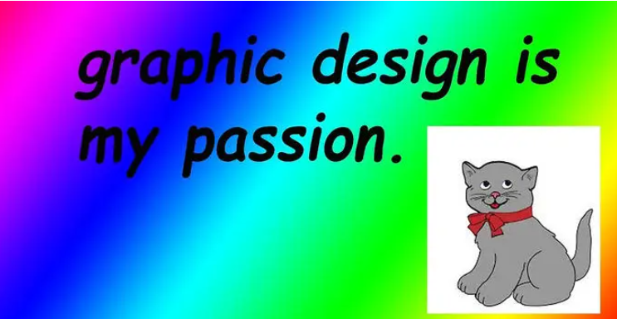
After Analysis
Once the needs of the user are clearly understood and documented…
Aka the Analysis Phase
The next stage is the DESIGN of the system.
software

Slide 4

Design Techniques
At National 5, you will need to know how to explain and implement three design techniques:
Design of the User Interface (Wireframe)
Design of the structure of the software (Structure Diagram)
Design of the detailed logic of the software (Flowchart)
You will also need to read, understand, and write Pseudocode.

Slide 5
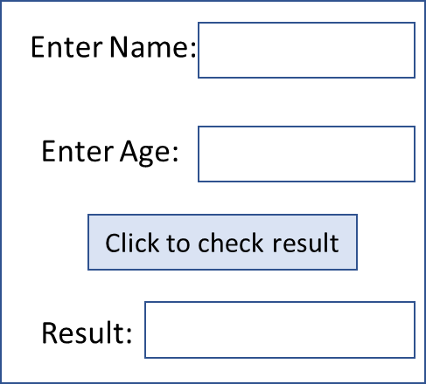
Wireframe (User Interface)
A wireframe is a diagram or sketch used to represent the appearance of a website or program.
For programs this will be a drawing of what the user will see when they run the program.
Input
Consider when designing:
How will data be inputted?
How will data be outputted?
What elements will you use (e.g. label, textbox, button)
Input
Process
Output

Slide 6
Worked Example
A program is being designed that will allow pupils to add money to their lunch money account.
The user enters their name, an 8 character password and the amount of money they want to add.
A button is then clicked and the updated balance of the account is displayed.
Design a user interface for this program. (3 marks)
Inputs
Process
Output

Slide 7
Worked Example
Inputs:
Username
8-character password
Amount of money to add
Process:
Add the money to account
Output:
Display new balance to user
What elements should we use?
Text boxes with labels
Button to click
Text area

Slide 8
Worked Example
Inputs:
Username
8-character password
Amount of money to add
Process:
Add the money to account
Output:
Display new balance to user
What should the interface look like?
Add money to your account
Username:
Password:
Amount to add:
Add Money
Your new balance is:

Slide 9
Design Tasks
Your turn now!
Software Design & Development

Slide 10
Structure Diagram
Structure diagrams are a visual design technique used to show the steps needed to solve a problem.
When reading a structure diagram start at the top and work towards the bottom.
If a level contains more than one branch, read from left to right before moving to the next level.

Slide 11
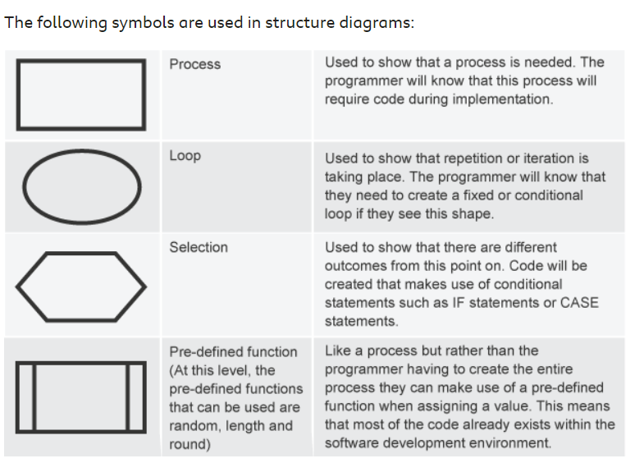
Structure Diagram
The following symbols are used in structure diagrams:

Slide 12
Basic Worked Example
A program which asks the user for a temperature in Celsius, converts it to Fahrenheit, and displays the converted temperature to the user.
Temperature Converter
Get temperature in Celsius
Convert Celsius to Fahrenheit
Display temperature in Fahrenheit

Slide 13
Worked Example with Condition
A program for an English teacher to enter the last 3 essay scores for a pupil and then display the average.
If the average is over 40, then student will achieve a pass for this work.
Essay Marking
Get essay scores
Calculate average score
Display average score
If average score > 40
Yes
No
Pupil passes
Pupil fails

Slide 14
Worked Example with Loop
Create a program for a nursery class that will help with their counting.
It will ask the pupil to type their name and then type the number of times it is to be repeated.
The name will then be displayed that number of times.
Counting Program
Get name
Get number of times to repeat
Display average score
Repeat number of times entered
Display name

Slide 15
Design Tasks
Your turn now!
Software Design & Development

Slide 16
Learning intentions and success criteria
I am learning…
I can…
About the design stage of software development
How to use design techniques to design a program
Describe the design phase and the aspects of software analysis
Design a program using National 5 techniques

